Slide 1
Online safety - a parent guide
What do you need to know, as a parent?
Locality E
Thom Winterbotham (Learn Sheffield)
twinterbotham@sheffieldclc.net

Slide 2
Keeping children safe online
What do you need to know, as a parent?

Slide 3
Online safety is a complex and ever-changing subject
What comes to mind when you hear the words ‘Online Safety’?

Slide 4
It’s so much more than
Stranger Danger
Social life
Behaviour
Money
Inappropriate images
Understanding of the World
Technology
Health & Wellbeing
Internet culture
Fake news

Slide 5
Talking to children
about their online lives

Slide 6
Children want to talk to you!
Children want to talk to their trusted adults about the online world, but they feel that…
Adults disapprove
Adults don’t understand
This makes them less likely to talk to anyone about issues they have, even if they want to

Slide 7
How do you stay relevant?
1) Seem interested (even if you’re not!)
2) Ask questions
3) Have a go (at whatever they are doing)

Slide 8

Behaviour puts young people at risk, not technology
Adults use powerful apps everyday
Our understanding of human behaviour keeps us safe

Slide 9

Parenting keeps them safer than settings
Although safe search settings and filters are helpful, they cannot block cyberbullying, scams, or live broadcasts

Slide 10
Parenting tips
Avoid
Try to
Judging or disapproving
Banning apps and sites
Confiscating devices
Overreacting
Take an active interest
Know what apps your child uses
Explore privacy settings for new apps together

Slide 11
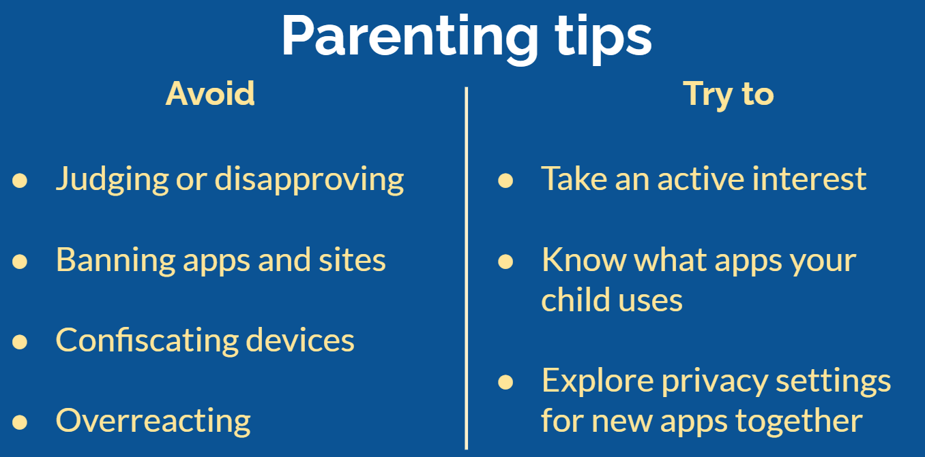
These are likely to cause your child to hide things from you
These are likely to cause your child to tell you things

Slide 12
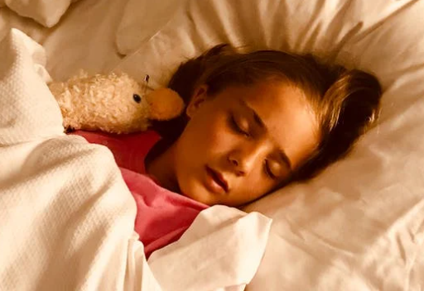
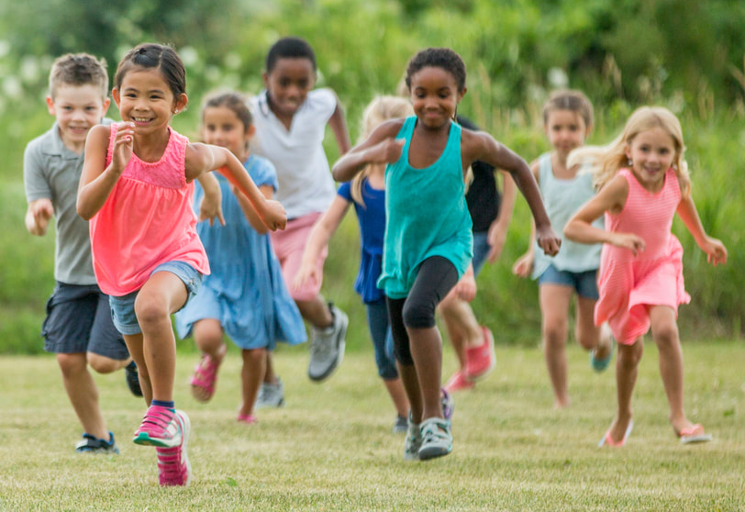
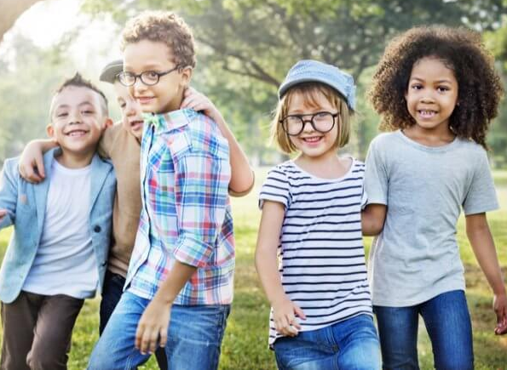

Screen Time
Spending time online is only a problem if it interferes with other things…
Sleep
Exercise
Socialising
Learning

Slide 13
Social media

Slide 14
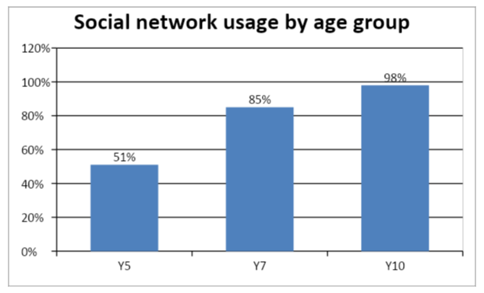
Social media use is on the rise
Notes:
The data from this graph is from before lockdown. The numbers are likely to be much higher now.

Slide 15
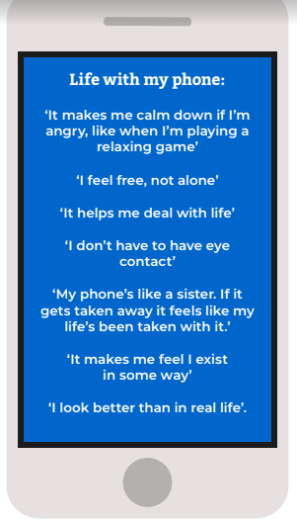
Social media can be great for children with SEND
Reduces isolation
Exposes SEND children to new potential harms

Slide 16




What apps are children using?
It varies from school to school, year to year, group to group, but here are the mostly popular for young people:
Snapchat
WhatsApp
Instagram
TikTok
Notes:
This list is only of the most popular apps - whatever your child is on, get to know it and find out about the risks using common sense media (next slide)

Slide 17
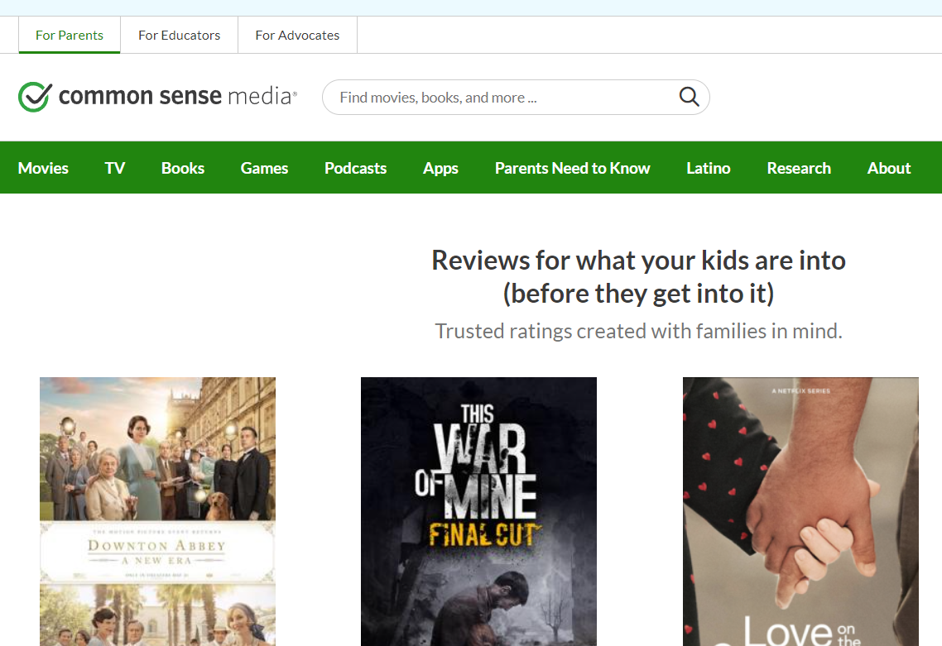
Useful website for checking suitability
Common Sense Media

Slide 18
Social Media - Top Tips
Turn off location settings (for example, in SnapChat)
Turn on privacy and safety settings where possible
  Internet provider (e.g. BT)
  Phone/tablet
  Apps
Regularly talk to your child about their activity
Notes:
1) Being careful with location settings is not just about hiding our address from strangers - it’s also prevents our friends from knowing too much information, and gives less power to cyberbullies
2) Privacy and security settings apply at multiple levels (network, device and app). Each has a different role in keeping children safe, but no settings guarantee safely. They should always be used in conjunction with good parental supervision and discussion
3) Depending on the age and maturity of the child, this may involve looking through their messages, but as the child gets older, this may be considered an infringement of privacy

Slide 19
Questions to ask when choosing apps to allow
Can we control who messages us? (can we make the account private
Can we block inappropriate contacts?
Can users livestream? (can this be turned off?)

Slide 20
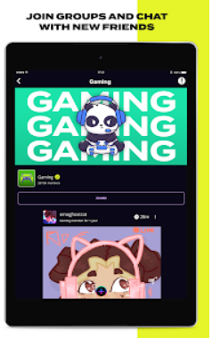

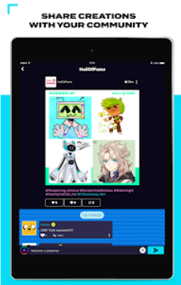
Try an alternative social media platform, designed for kids?
Moderated
Add friends that they know in person
Blocks photos of faces for safety
Share creative art projects
Notes:
1) Checked by authorised adults on the network
2) Calling online communication ‘real life’ can feel patronising, as - for many children, the online world is of similar importance to the offline one
A barrier to using this app is that their other friends would have to use it too - the whole point of social media is to feel connected to other members of the group, so unless there is high uptake, children may be disinterested

Slide 21
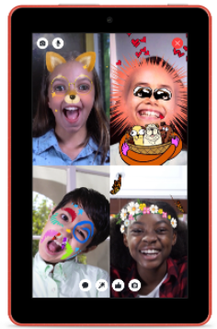

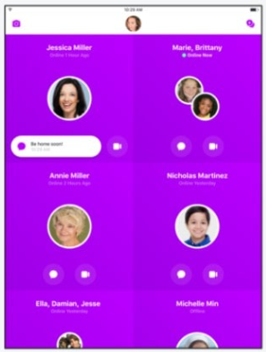
Try an alternative social media platform, designed for kids?
Made by Facebook
High levels of parental control
Facebook will monitor and analyse your child’s data (as they do with all of their products)
Notes:
Parents sign up for account and can closely monitor their child’s activity

Slide 22
Online risks

Slide 23
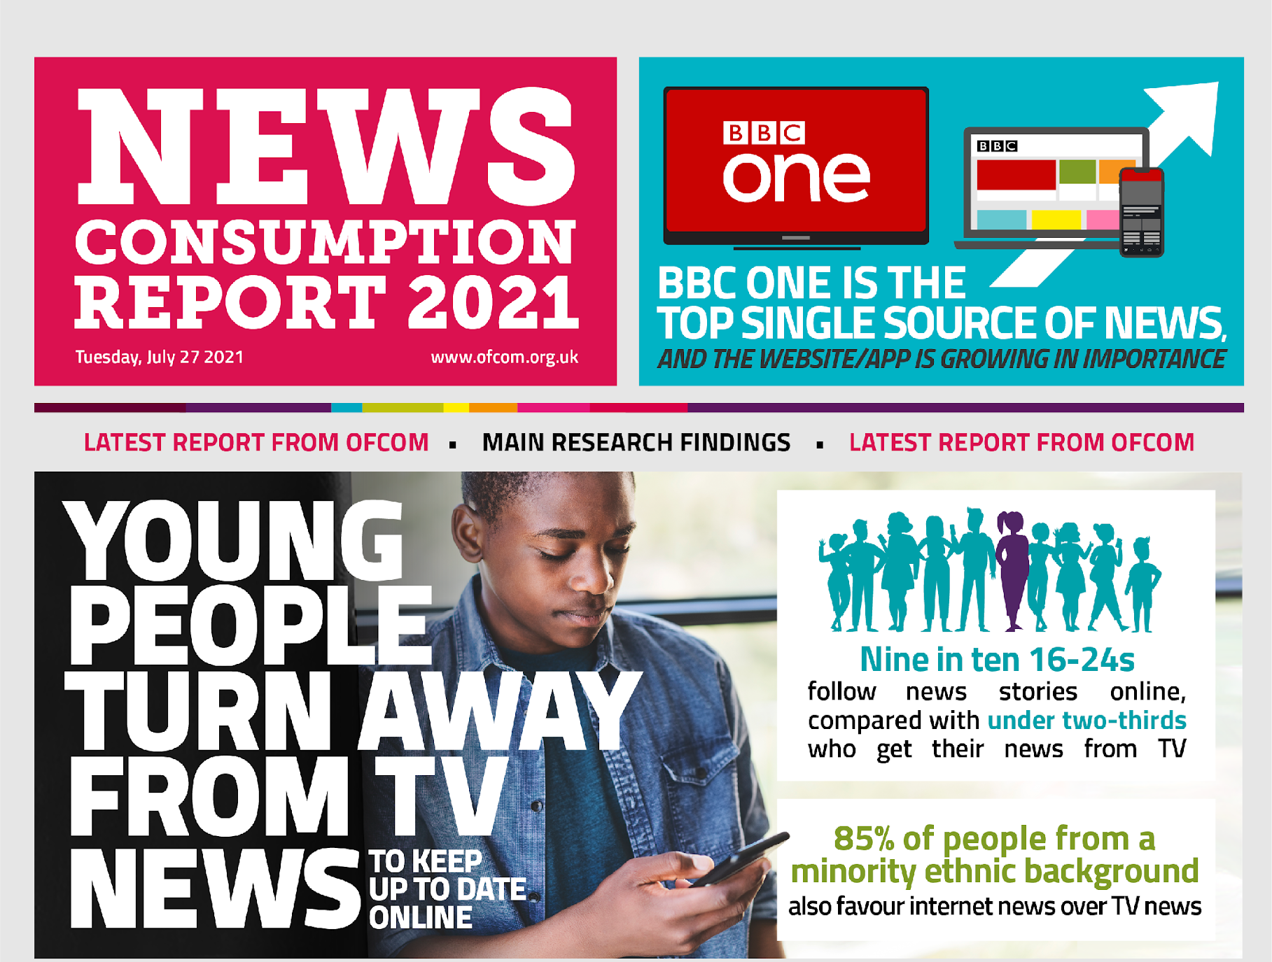
Where are young people getting their news?
Increasingly from:
YouTube
Instagram
Facebook
Notes:
Increasingly, people are getting their news from informal social media instead of mainstream news channels - which has both good and bad consequences, but ultimately has led to the rise of conspiracy theories

Slide 24

Young people experience pressure in the online world:
To be online and reply quickly
To get likes
To look “right”
Worrying about friends
Being asked for images
Not knowing what is real or not
Notes:
Expected response time for replies on social media can be very pressurising for young people
Social media use has massively increased since lockdown

Slide 25
Online exclusion?
Being active online is now part of normal social activity for children in primary school
It is an important part of most young people’s social life
If all the other children in your child’s friendship group are using an app, should you allow them to use it too?

Slide 26

Body image
Young people are often confronted with videos aggressively pushing body-conscious exercise routines and diets. This can have the result of lowering self-esteem and increasing the likelihood of developing eating disorders.

Slide 27
Choosing what to do online
Young people need advice on what to do - and what NOT to do - when they are online. Parents, carers and older family members are in the best position to guide them.
For example, adults should be aware that there are websites that promote dangerous behaviour, such as:
Self-harm and suicide
Disordered eating (such as anorexia and bulimia)

Slide 28
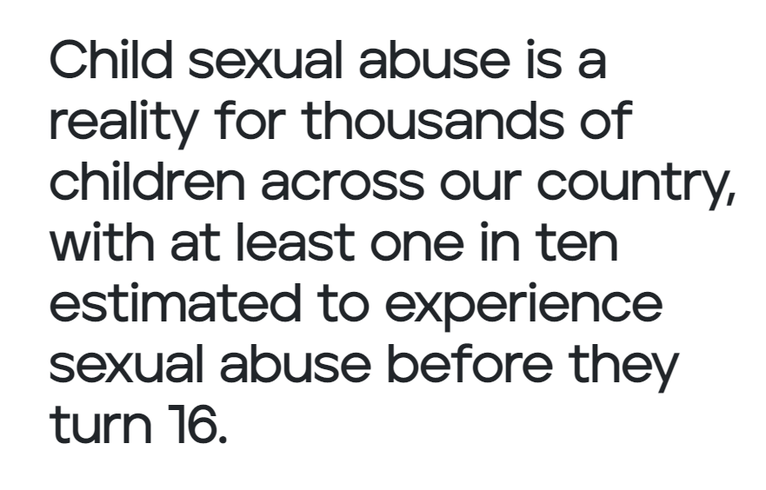
Trends in online sexual exploitation
https://stopabusetogether.campaign.gov.uk/

Slide 29

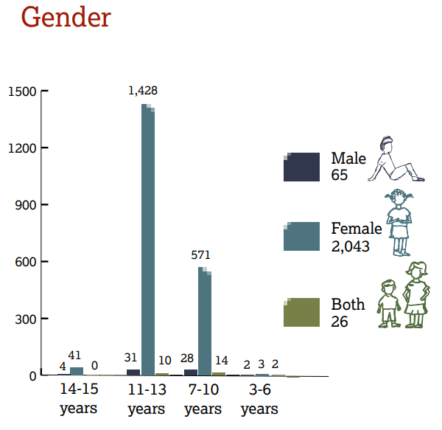
Trends in online sexual exploitation
https://www.iwf.org.uk/sites/default/files/inline-files/Distribution%20of%20Captures%20of%20Live-streamed%20Child%20Sexual%20Abuse%20FINAL.pdf
Notes:
Sadly, the most vulnerable group for online sexual exploitation is girls at the end of primary school and the start of secondary.
The vast majority of cases happen with children in their own houses, with parents or carers in the house (unaware of the exploitation occurring via the child’s device. There is no strong correlation of abuse with regards to social demographic. I.e. all children are potential victims. Children with special needs and disabilities are at higher risk.

Slide 30
Tips to protect children from online sexual abuse
Spot the signs
Talk to your child
Use settings and filters
https://stopabusetogether.campaign.gov.uk/
Notes:
1) Be observant
2) Build good relationships
3) Use technology to support

Slide 31
Spotting the signs of abuse
Look for changes of:
Mood
Behaviour
Friends (particularly online ones)
More information: https://stopabusetogether.campaign.gov.uk/spot-the-signs/
Notes:
1) Mood - Depression, anxiety, reverting to younger patterns of emotion, excessive worry about contact with online ‘friends’
2) Behaviour - bedwetting, discomfort around genitals, sexual languag, secrets, eating habits and self harm
3)Friends (particularly online ones) - are they known in person? Are they older? Are they kind in their language, do they demand secrecy from the child? Is the child receiving gifts?
https://stopabusetogether.campaign.gov.uk/spot-the-signs/

Slide 32
Reporting to school
It is appropriate to report concerns to school when you are worried about…
Unhealthy relationships
Bullying (including online)

Slide 33
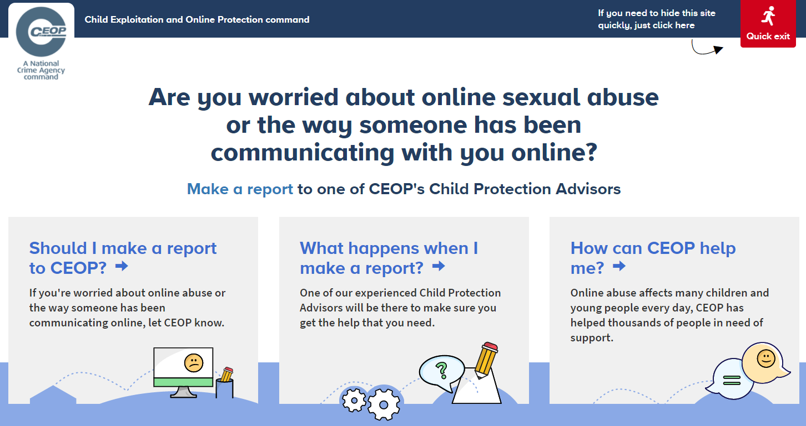
Reporting to the Police
Go to www.ceop.police.uk
Notes:
If a child is being sexually exploited or is in danger, contact the police immediately

Slide 34
Top tips

Slide 35
New apps - what to do
Take time to explore the privacy settings together
Choose ‘Friends only’ instead of public
Decide what kind of personal information to add to the app (use avatars and usernames)
Practice how to block and report any negative users

Slide 36
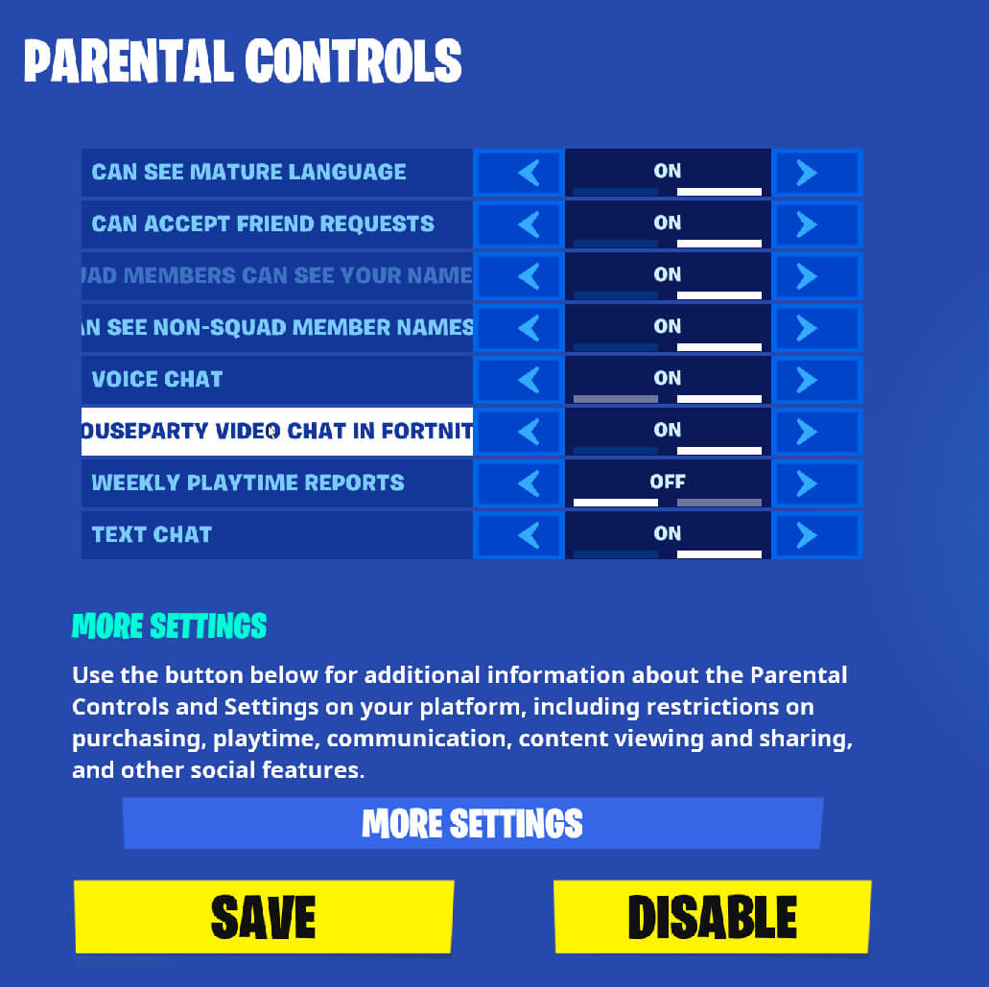
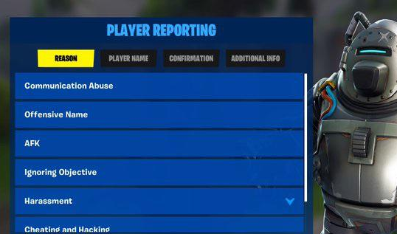
Example: Fortnite

Slide 37
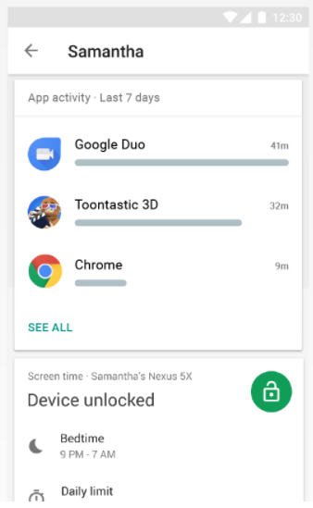
Technical settings on devices
Google For Families
For google accounts
For android phones

Slide 38
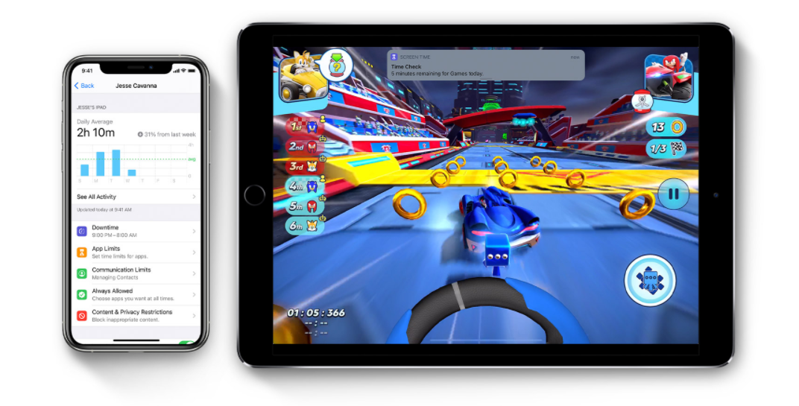
Technical settings on devices
Apple screen time

Slide 39
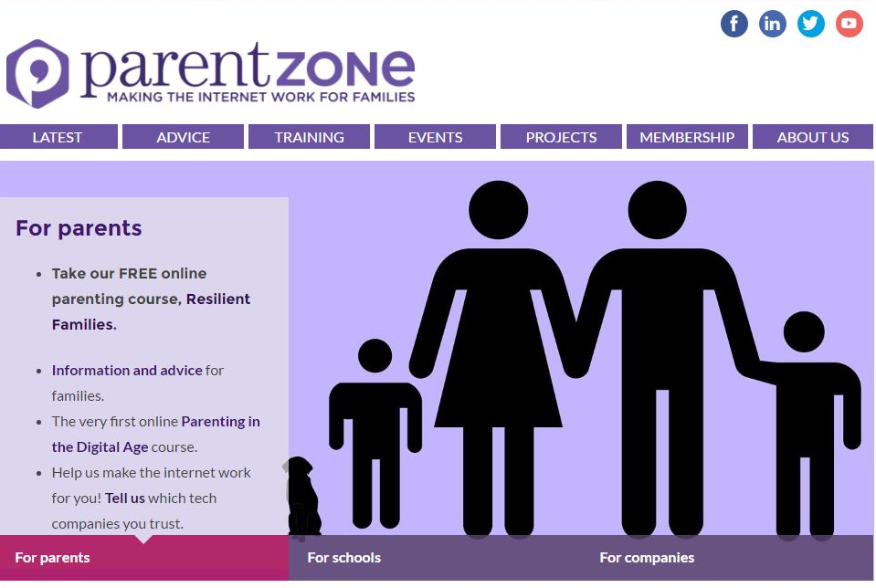
Getting further advice

Slide 40
Checklist for parents
I have asked my child to show me the sites they use.
I have checked my child’s privacy settings.
I have asked my child about their online friends.
I have set appropriate controls on the computer/laptop, gaming and mobile devices.
My child has agreed to tell me if they are worried about something online.
I know where to get help if I’m concerned about my child
We have rules about where and when devices may be used

