Slide 1

End of Year Report

Slide 2
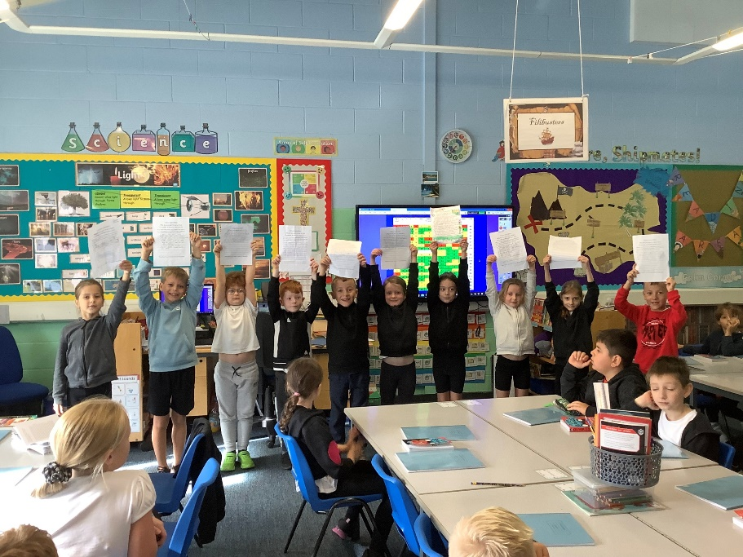
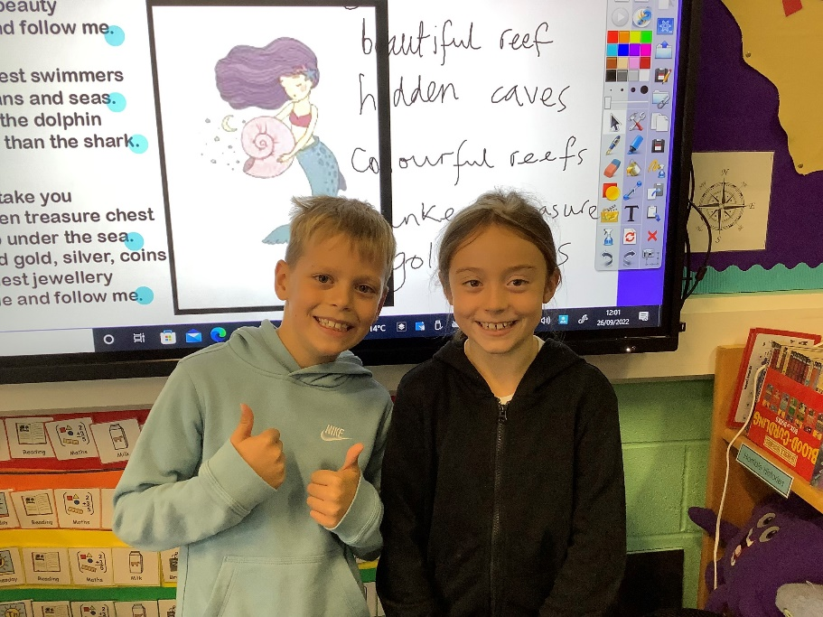
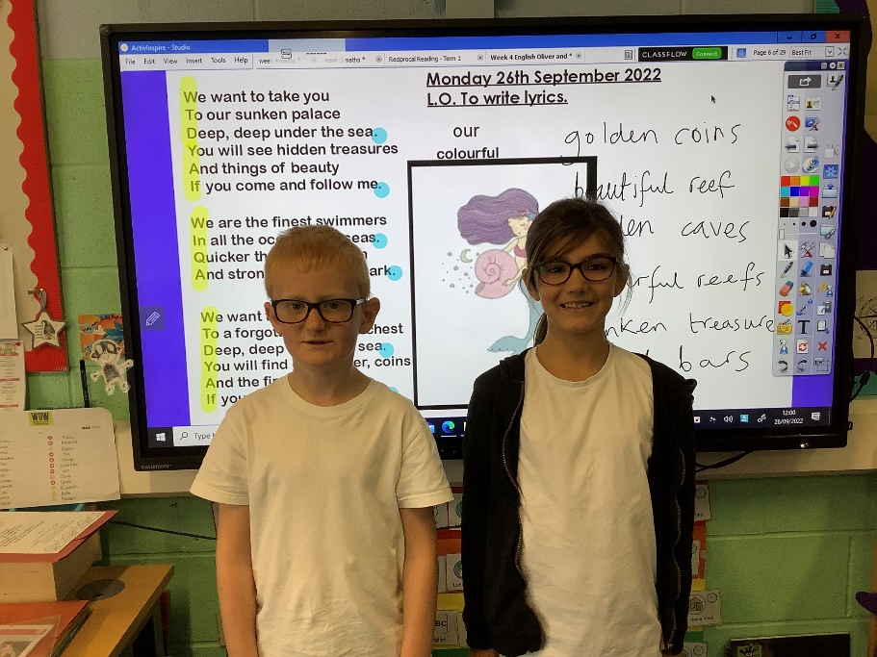
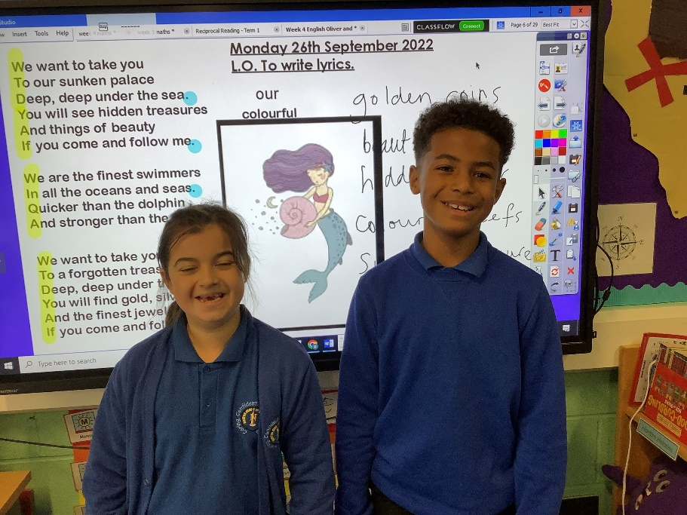
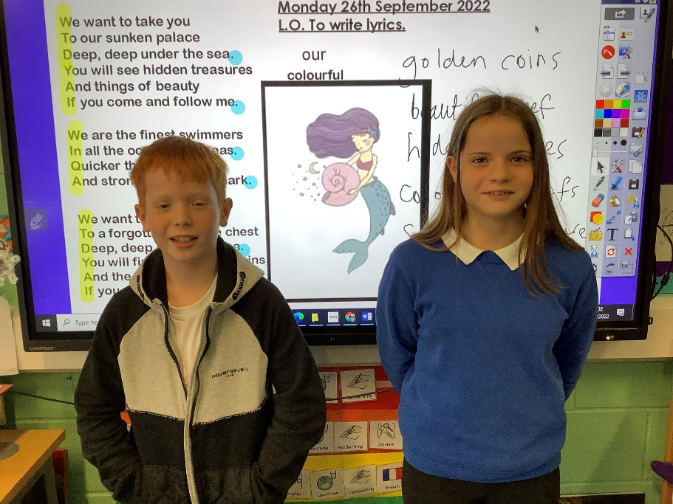
In September 2022 Mr French set up an Eco Council Committee.

Slide 3
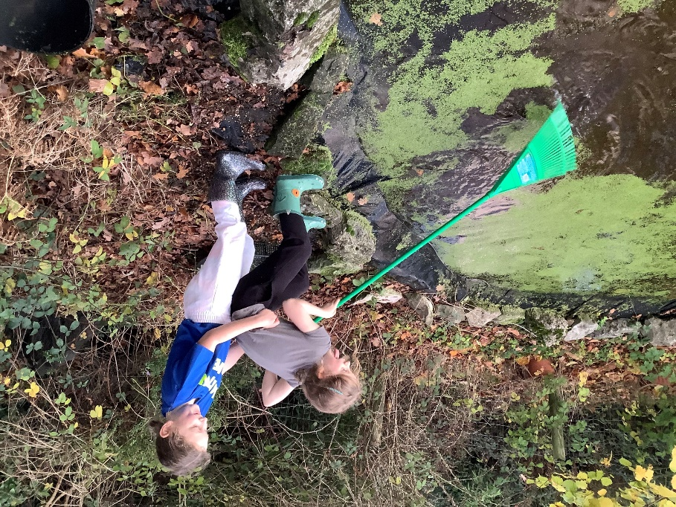
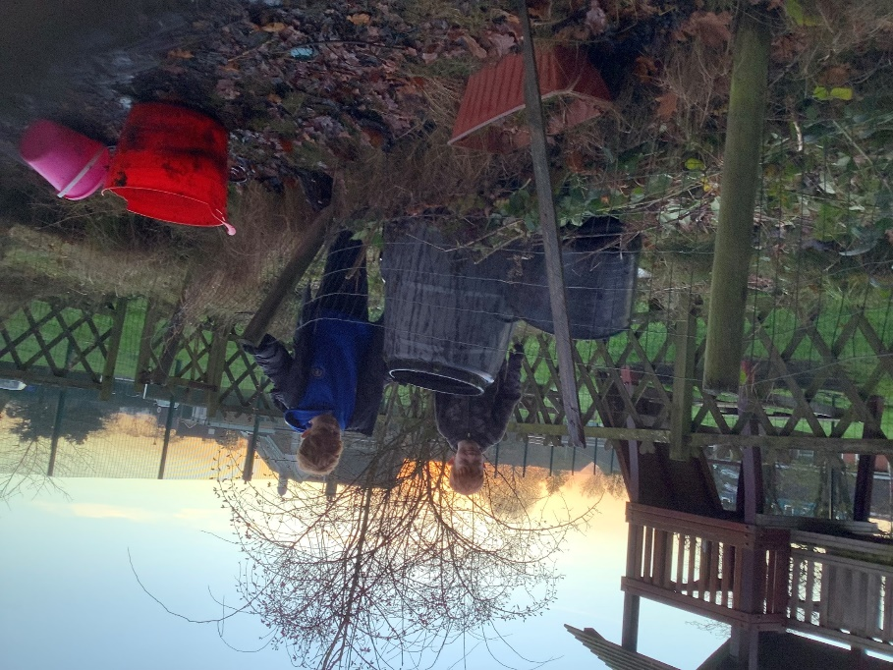
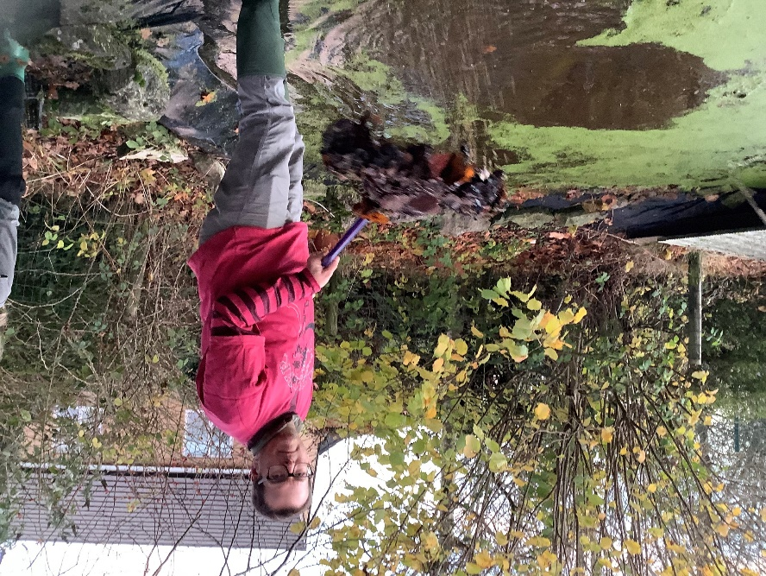
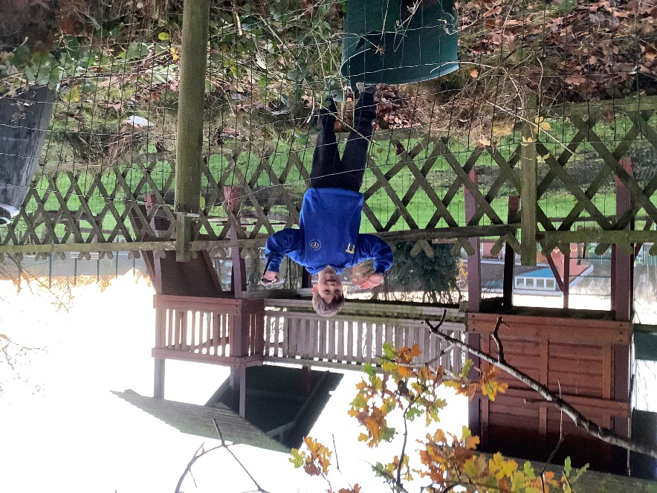
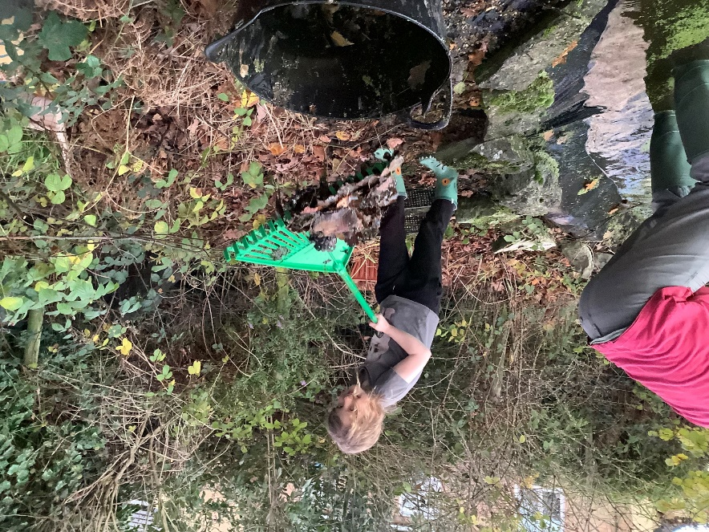
In October, he also set up the Pond Cleaning Club. It was only going to run for 4 weeks but it was too much fun to stop – and there was plenty to do!

Slide 4
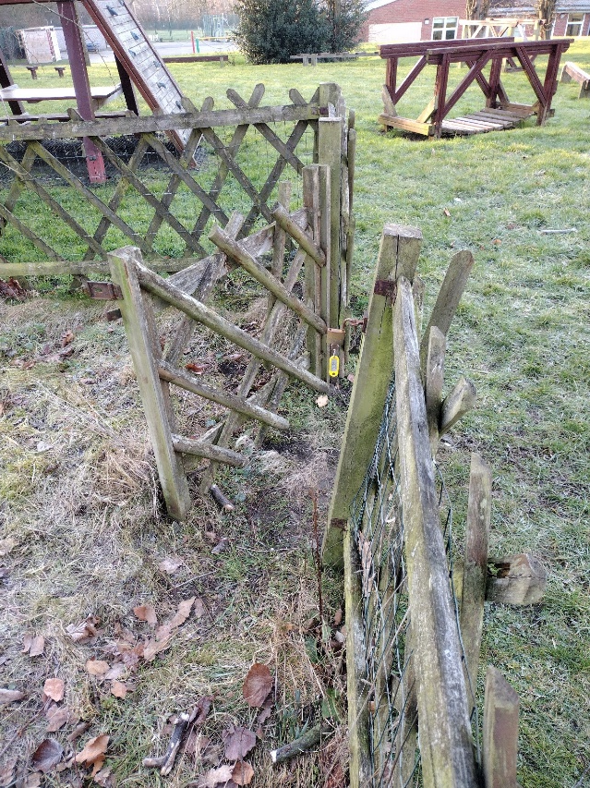
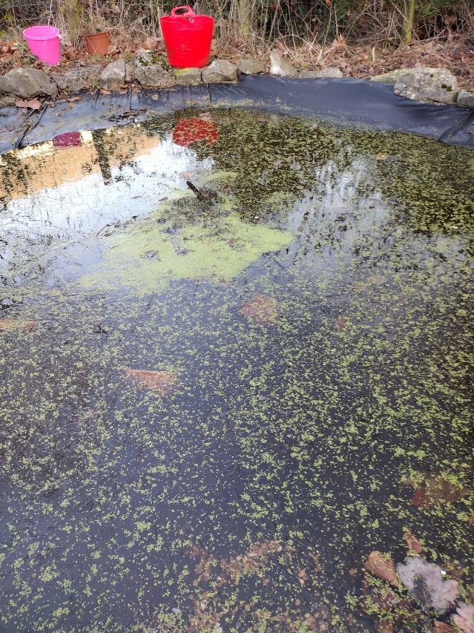
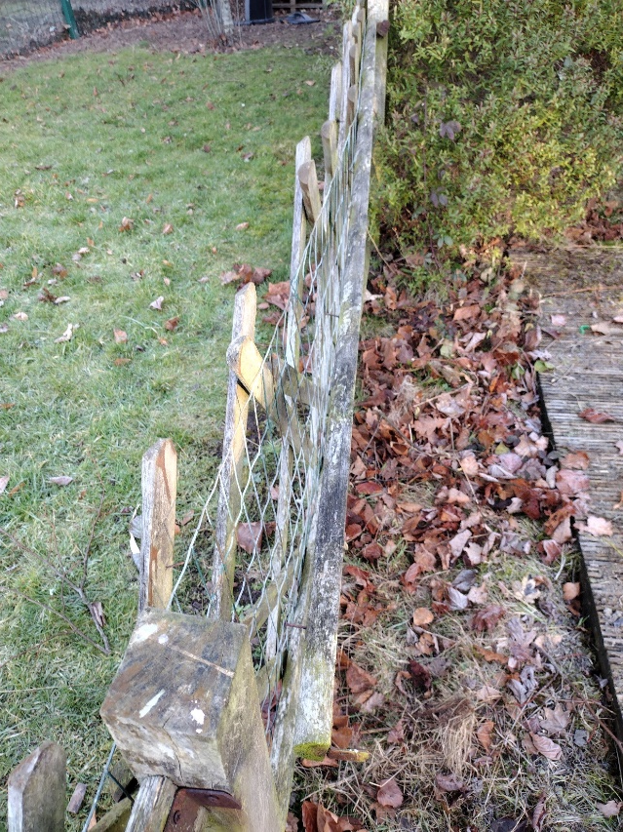
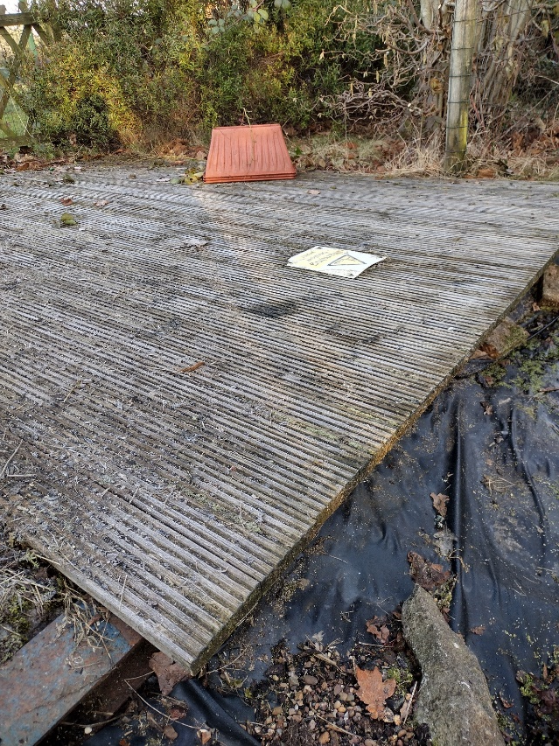
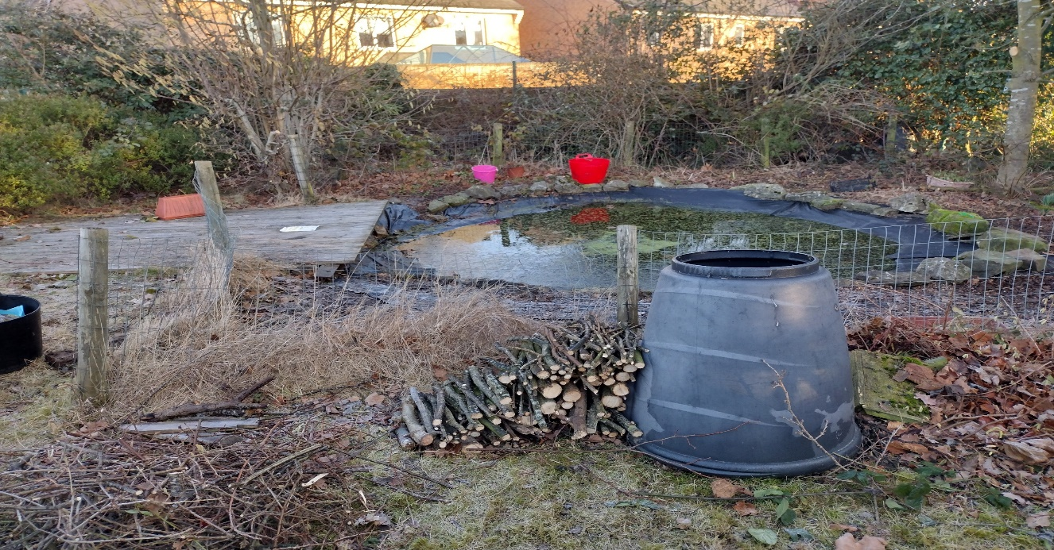
Gate needs replacing
Pond lacks life
Fence is wonky
Decking is rotten
For Green Flag status we had to choose 3 topics that would benefit our school and the environment. These were; School Grounds, Biodiversity and Energy.
Our first topic was School Grounds and we decided to concentrate on the big puddle in the corner of the field.
The Pond Club meet every Monday (rain or shine) to tidy up this area.
General clean up needed

Slide 5
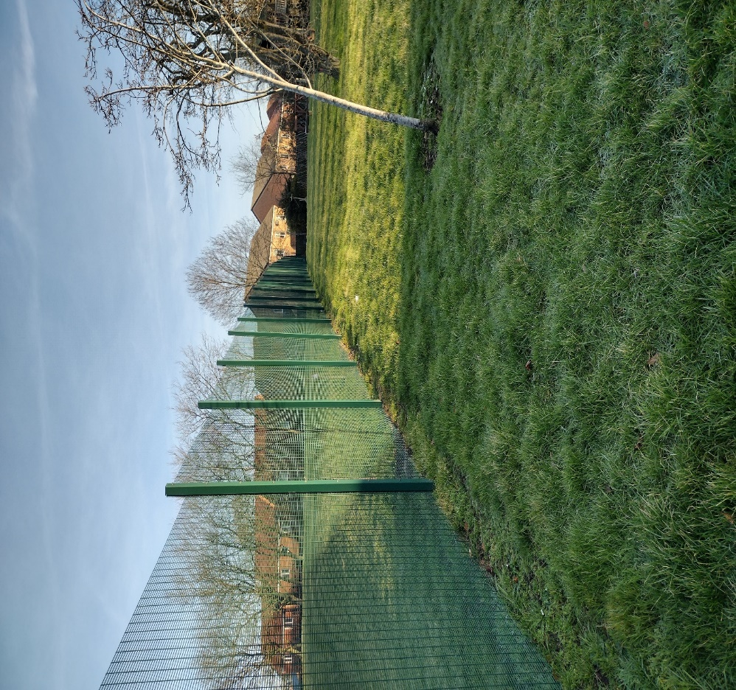
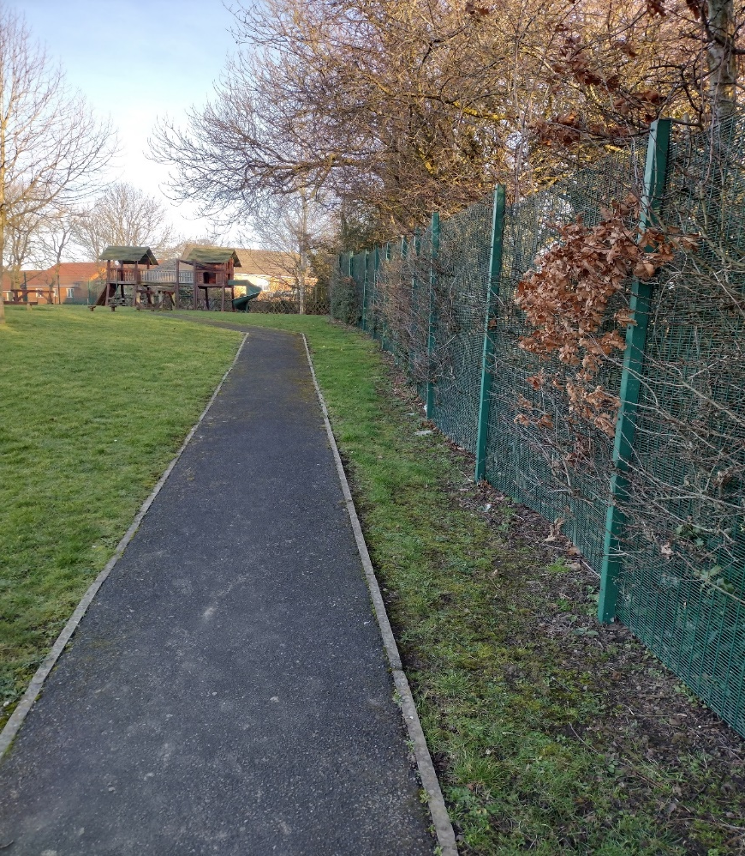

Border flower beds needed
No-Mow May is needed
Wildflowers are needed
Our second topic was biodiversity. We wanted to attract more insects, birds and wildlife into our school grounds. We are so lucky to have some green spaces so lets make the most of what we have and have more discussions about wildlife.

Slide 6
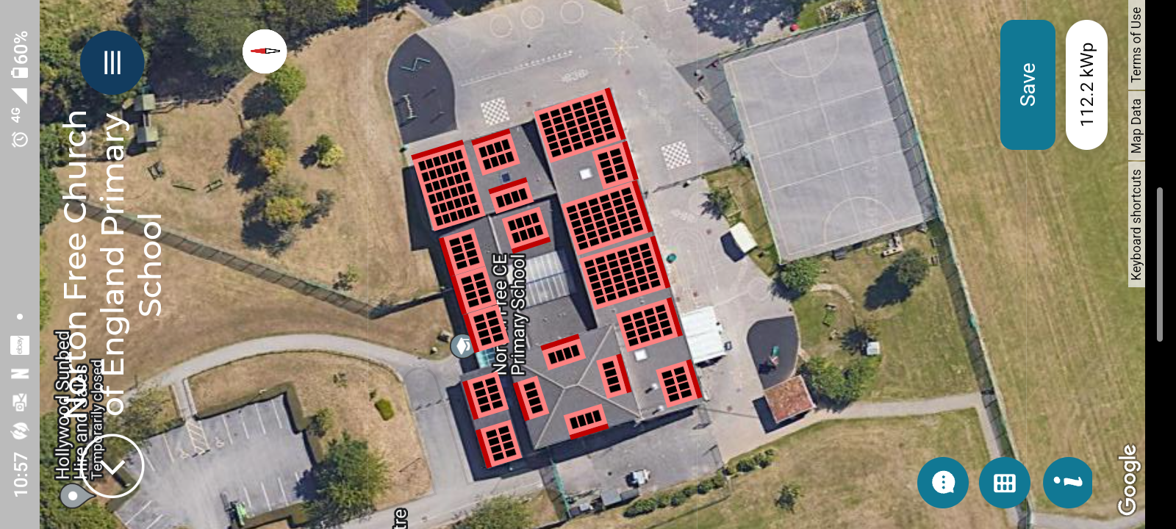
We used the Solar for Schools App to work out how many solar panels could be fitted to our roof
Energy is a major issue at Norton Free and was chosen as our third topic. We have reduced the amount of water and electricity we use but this has not helped with soaring energy bills. Mr French and the Eco Squad are on a mission to install 380 solar panels onto our roof – saving £9,000 per annum and creating £10,000 of energy!

Slide 7
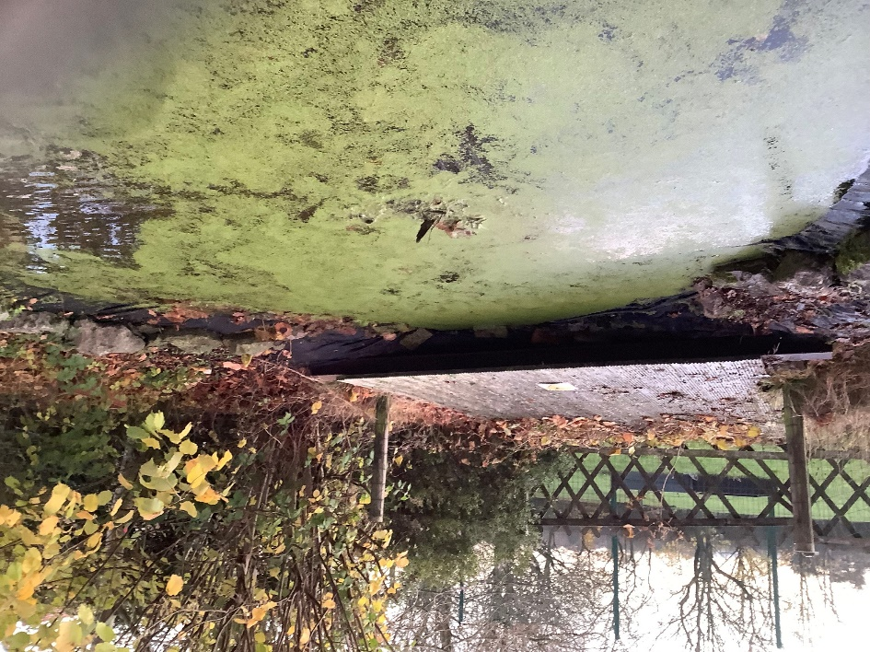
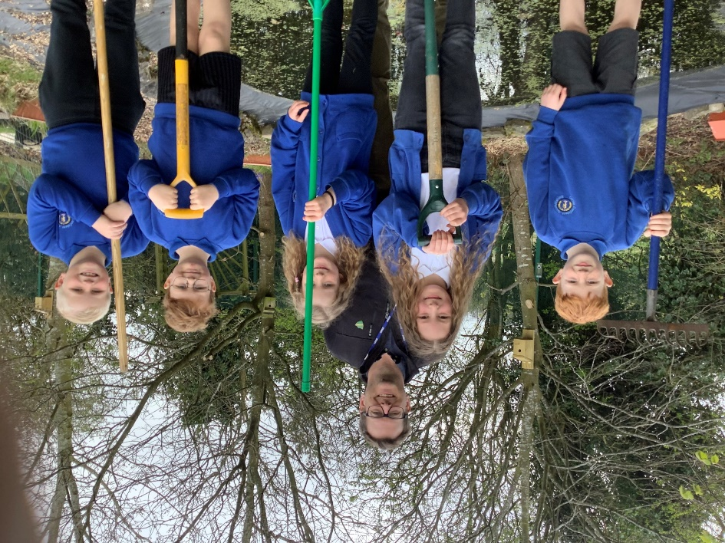
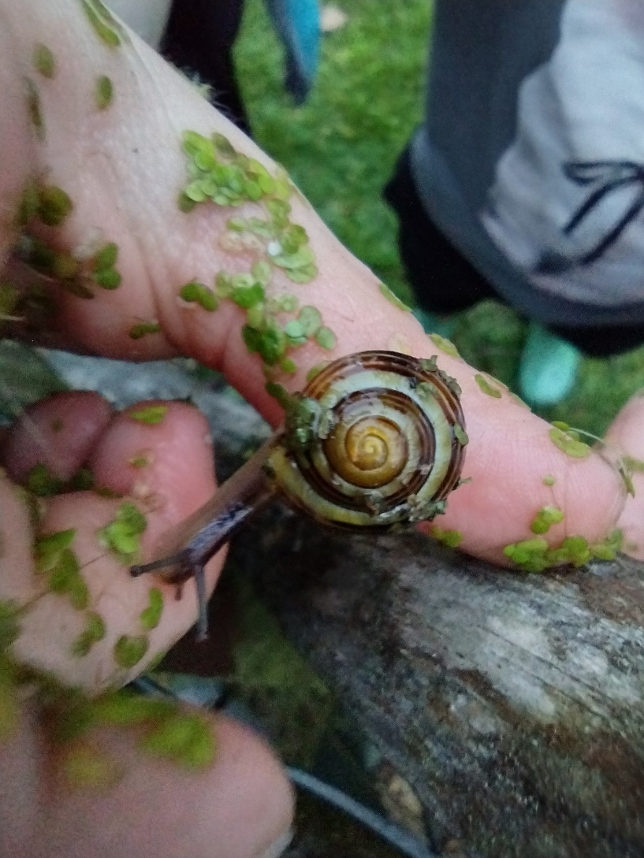
The Eco Team calculated that we would need at least £1,000 to build a new
Fence and bring in some pond plants.
We entered the OVO Nature Competition.
We had to include a 3,000 word essay on what we would do with the prize money and a break down of what we would spend it on.
Not one business replied! However, in early March we heard that we had won the top prize! We had the money to buy much needed plants and a new fence.
In May, Mr French saw a poster in Wickes that said they help out with community projects. By July, they had offered us £400 off the cost of a new fence – result!!
In addition, we had to prove match funding with local businesses. This took a long time to complete. Twelve letters with self addressed envelopes were sent out.

Slide 8
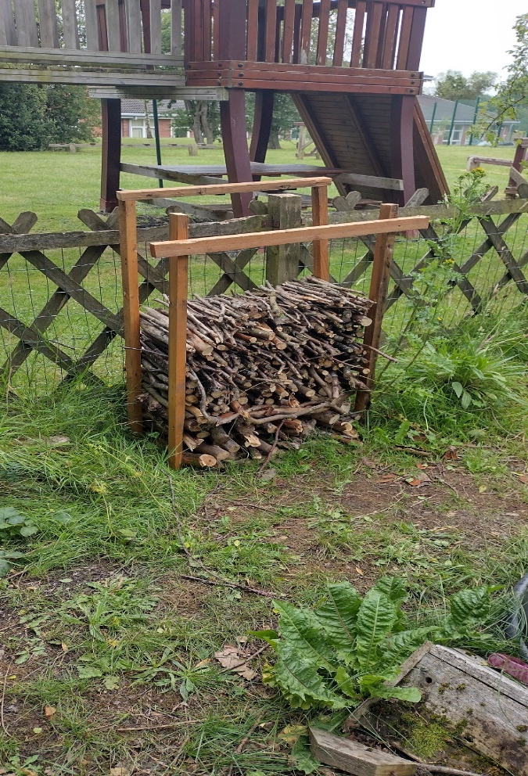
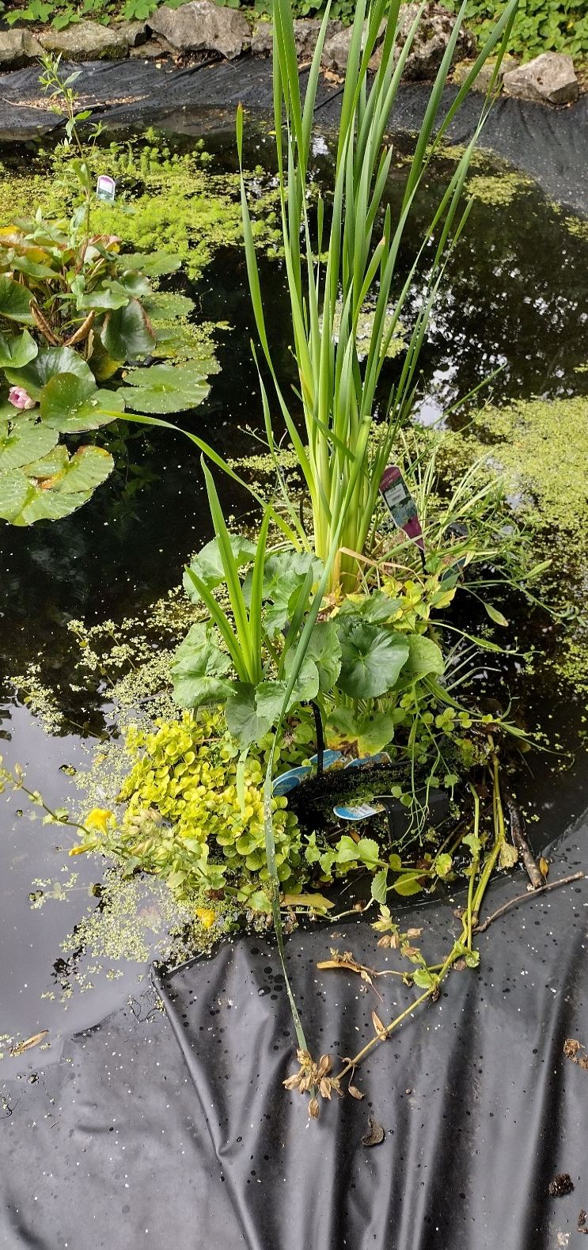
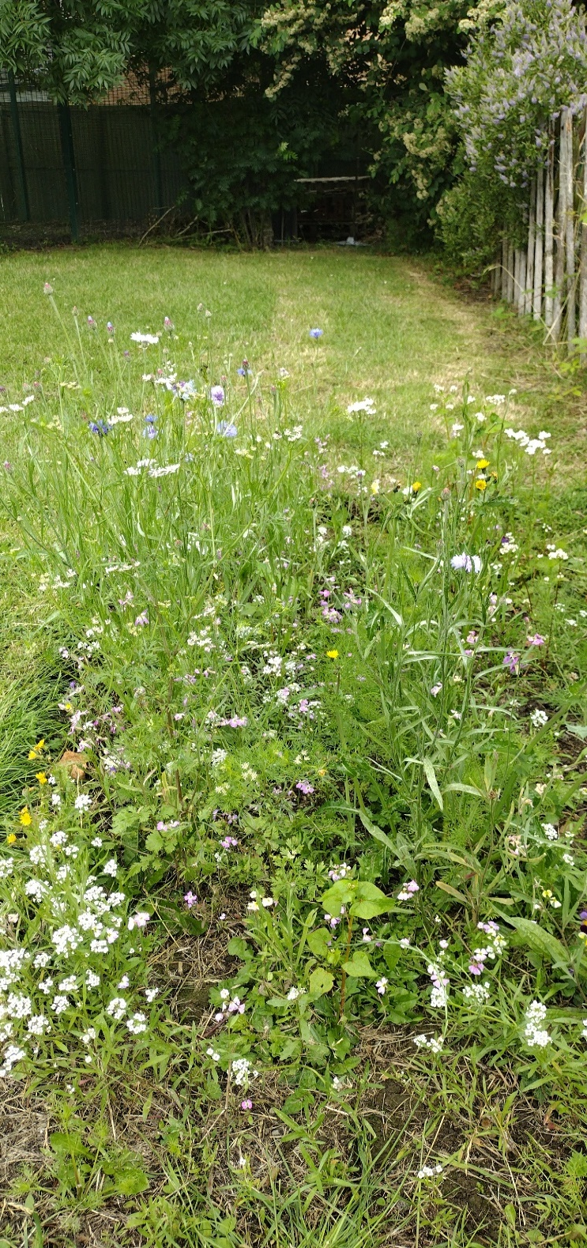
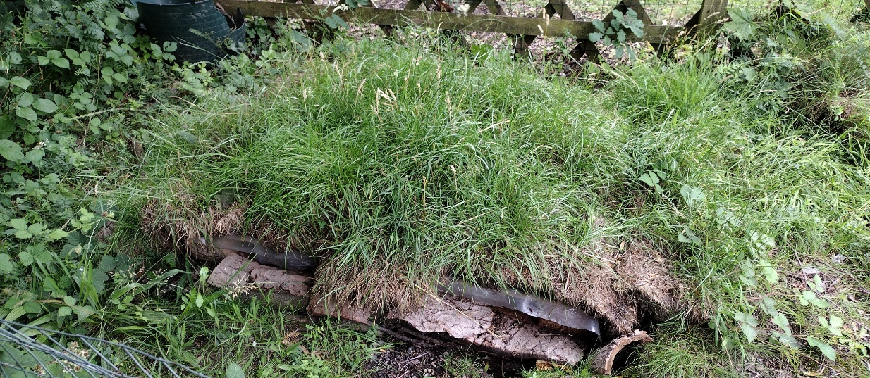
We have built an extra large insect hotel. We also built a hibernaculum for amphibians – it took 3 weeks to dig that hole! We are really proud of our wildflowers – watered every day during the heat wave. The sale of DVDs meant we had £100 to spend on pond plants! That was a lot of trips to the Post Office to send out DVD’s!
Wildflowers that attract bees
Insect Hotel
Hibernaculum
Pond plants; Oxygenators and Marginals

Slide 9
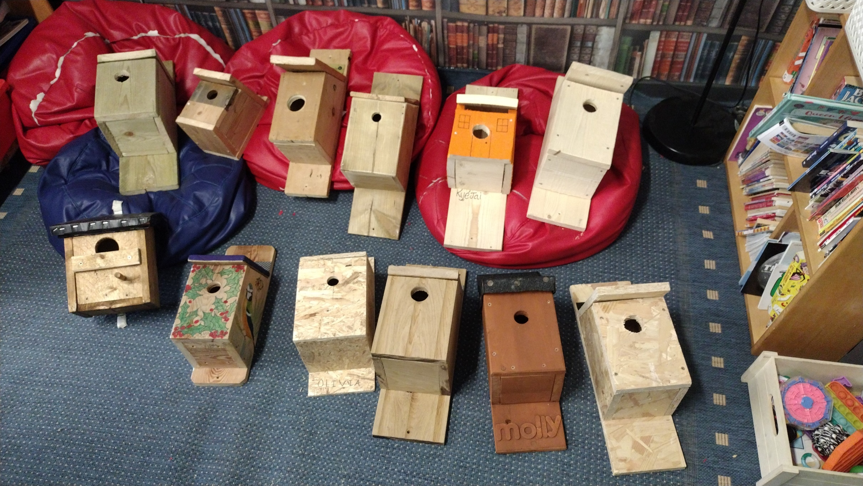
All the boxes have been placed around school
We demonstrated to the OVO Foundation how serious we are about wildlife by creating these bird boxes. All 12 boxes were made by the children from Year 3 – we are still waiting for Mr Holland’s! We have secured all the boxes around the school grounds to help with biodiversity. We even gave one to Arbourthorne Community Primary School.

Slide 10
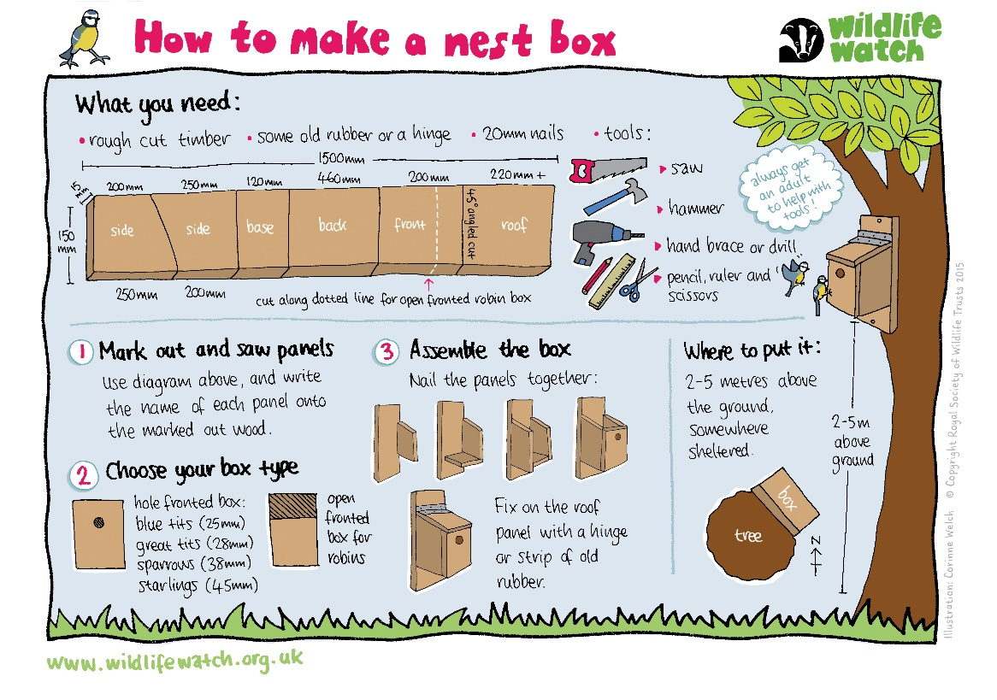
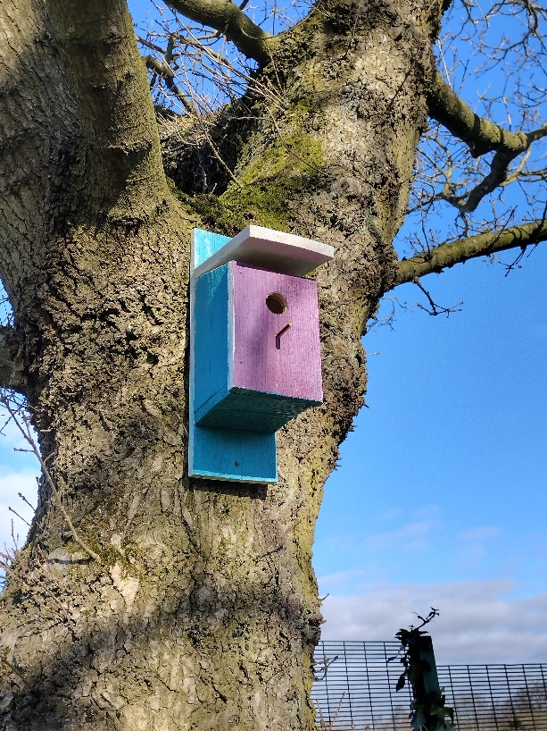
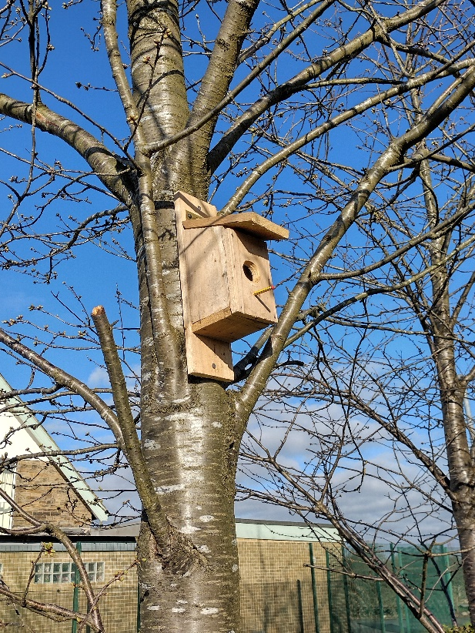
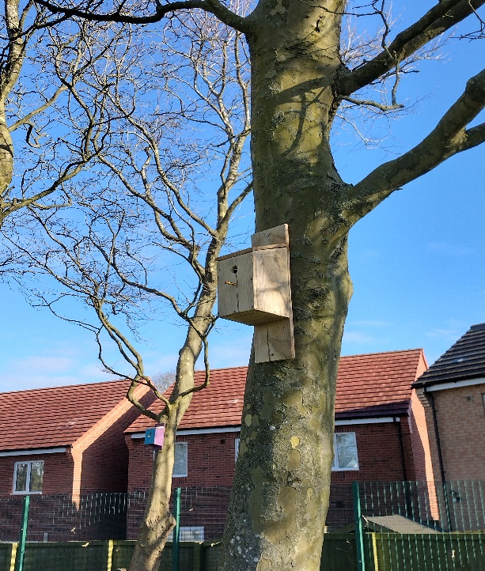
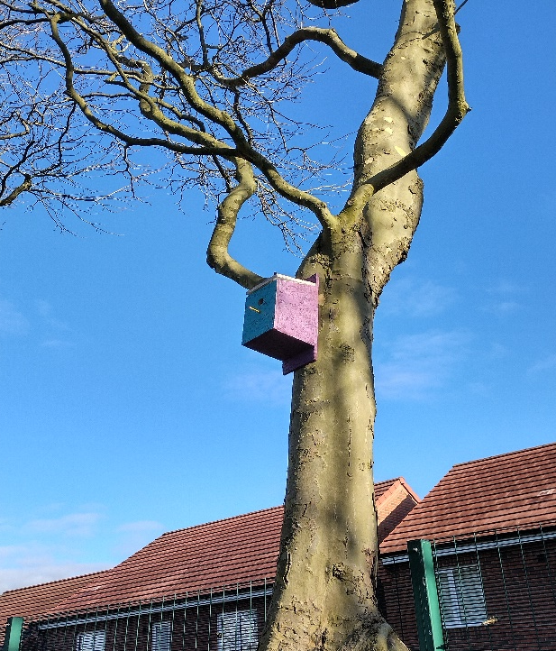
Biodiversity has been very successful. We had a ‘No-Mow May’ which meant more flowers could grow and the Insects have also been attracted to our newly planted wildflowers. We had nesting birds in 2 of our boxes and we hope to have more next year.
The pond has spawned hundreds of frog lets. Some have been seen hopping into the hibernaculum. During our pond weed clearance we scooped up a newt! This was incredible news because it meant the pond was healthy.
We will keep our eyes open for any other wildlife in the years to come.

Slide 11
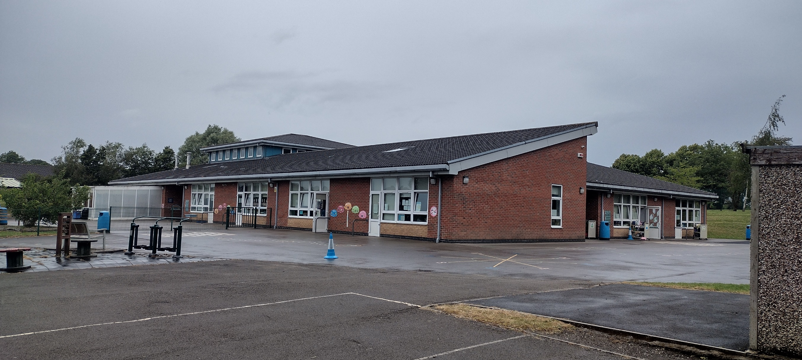
Our angled roof is perfect for solar panels – 380 of them!
Our biggest challenge is the soaring energy bills. We have a massive roof space. Wouldn’t it be great if we could fix solar panels to our large school roof! Mr French and the Eco Council have been extremely busy getting our voices heard. We have travelled to Sheffield Town Hall with our proposal and delivered letters to the Chief Operations Executive. The council has a vision of zero carbon by 2030 – we have told them that we want to be part of that vision.

Slide 12
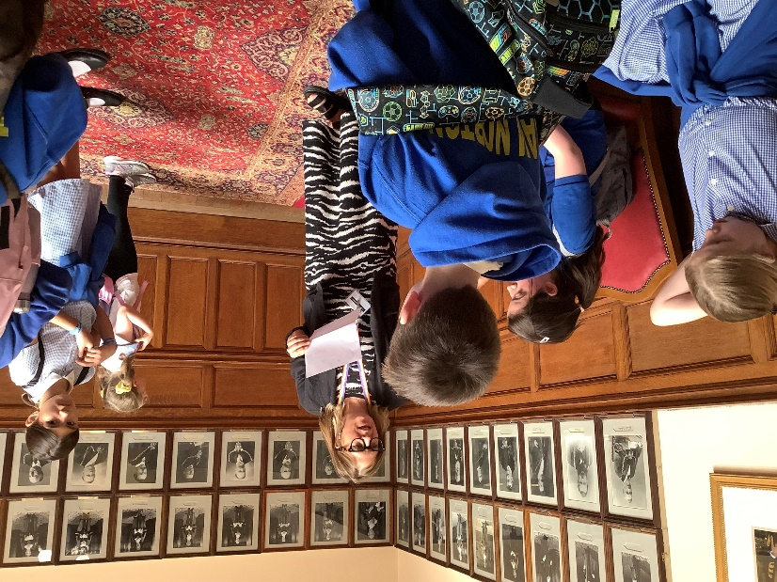
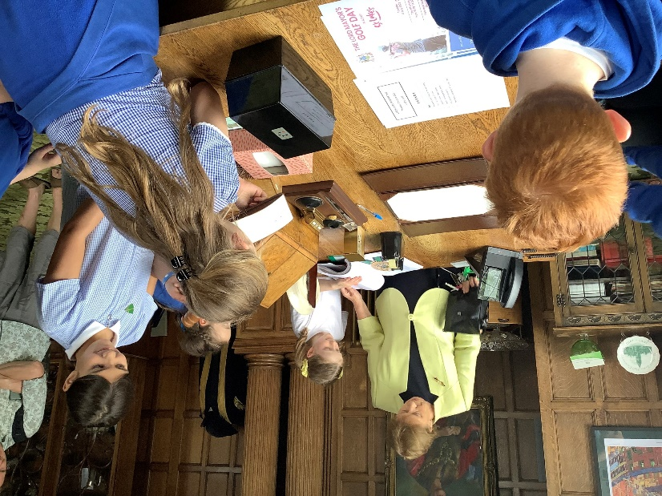
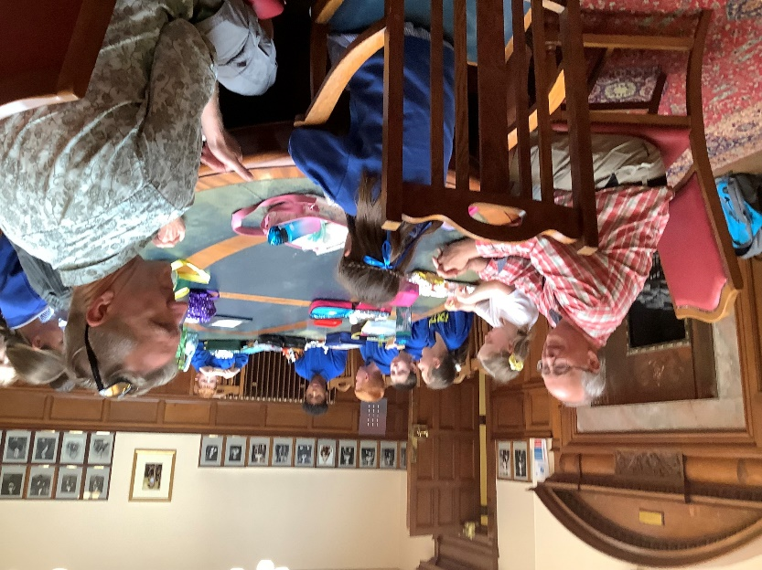
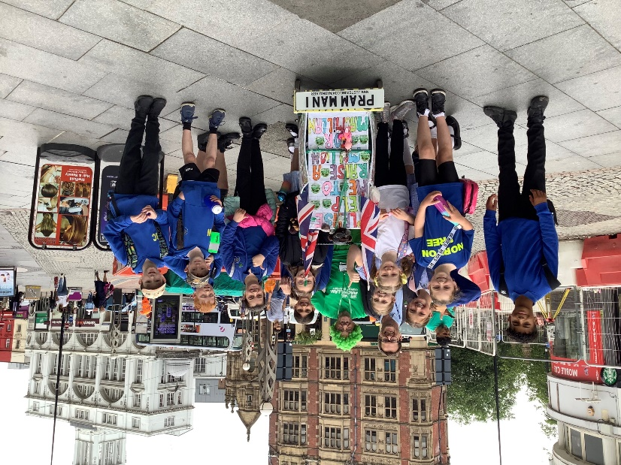
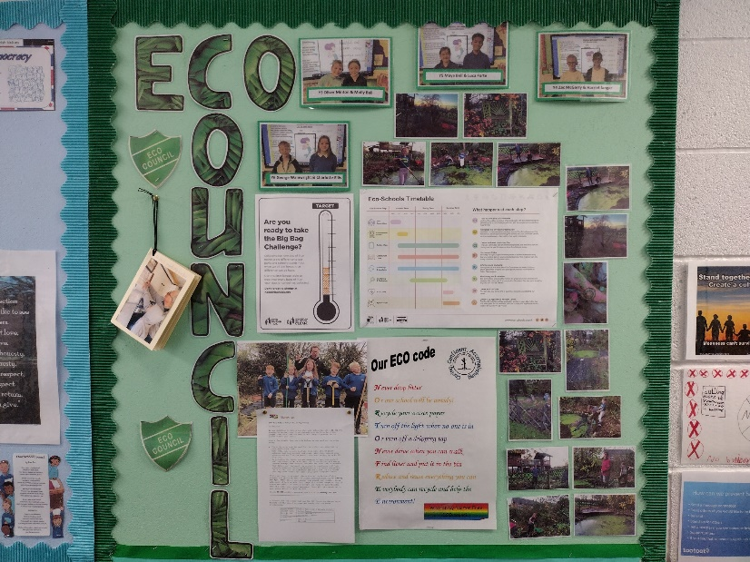
Gail Smith – Ex Lady Mayoress
Green Councillors Paul Turpin and Bernard Little
Claire Taylor – Chief Operations Executive
We have met a number of different people on our journey this year including councillors, chief executives, Lord Mayoress’s local businesses, local schools, parents and fundraisers. We have sent off dozens of emails and letters. We have generated over £1,500 for our projects through competitions, sales of DVD’s and Candles and the generosity of local business.
Man with Pram – John Birkwith

Slide 13
The Eco Schools application began in October and has taken us on an amazing journey. However, the voyage is far from over. We still need the council to help us with our solar panels. We also need to develop our biodiversity with new compost heaps, a sensory garden and more wildflowers. The fence and decking needs to be built and the pond needs more plants. The Pond Club all say they want to continue in 2023 – 2024. We have lots to do and can’t wait to get going on our return in September! – The Eco Team

