Slide 1
Phonics
March 2025
Mrs Sewell

Slide 2
Why does it matter?
Phonics is the foundation of reading and writing.
It is the only way we teach reading at the moment.

Slide 3
Share how phonics is taught
Help you help your child with phonics
Introduce you to phonics terminology
Outline the different stages in phonological development
Show examples of activities that we use to teach phonics

Slide 4
What is Phonics?
Phonics is the link between letters and the sounds that they make.
Phonics is all about using skills for reading and writing.
Learning phonics is a key skill as it will help your child become a good reader and writer.

Slide 5
Phonics at Norton Free
Children begin to learn phonics in Foundation Stage and continue throughout Key Stage 1. Phonics is sometimes continued in Year 3.
Lessons encompass a range of stories and actions that enable children to remember new sounds more easily.
There is a lot of repetition so children do not get left behind.

Slide 6
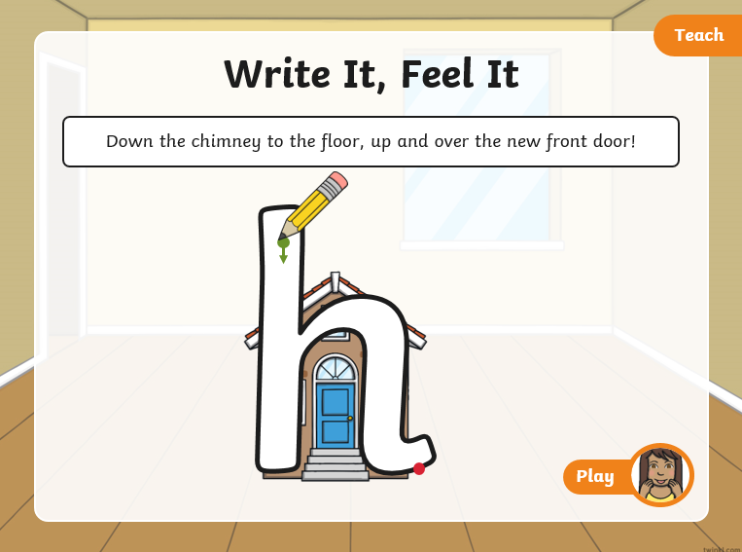
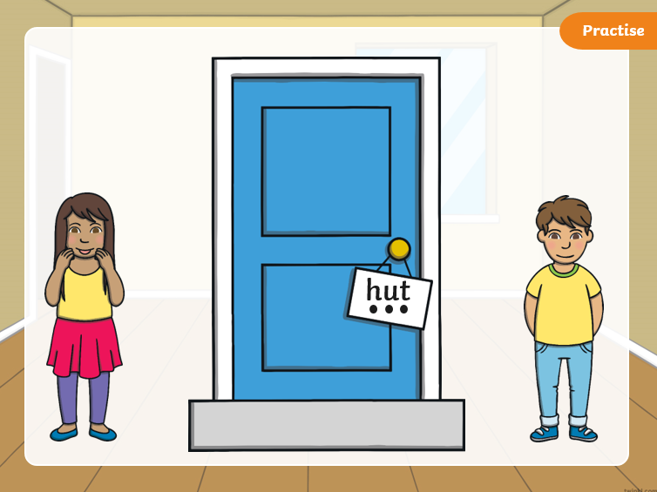
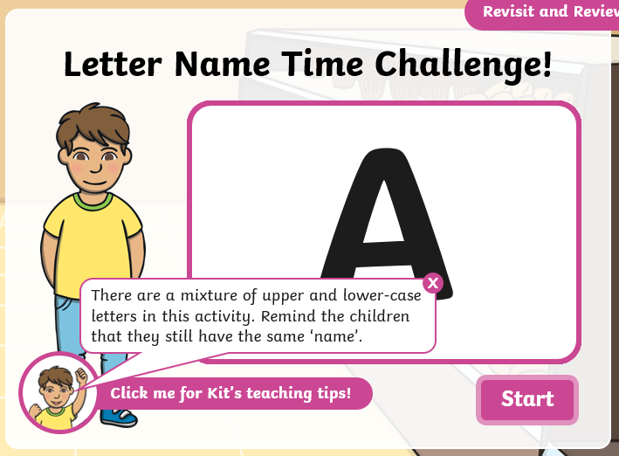
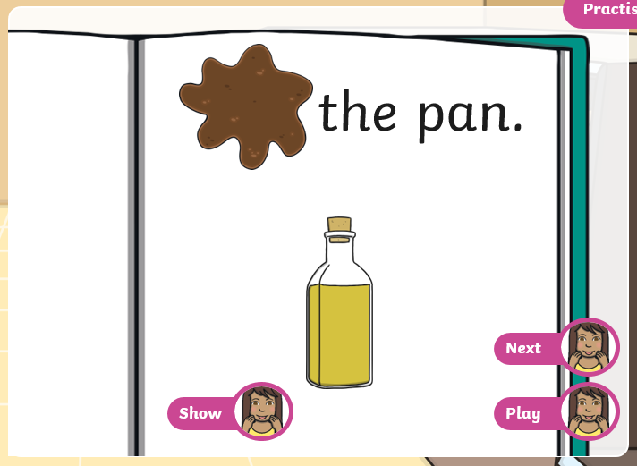
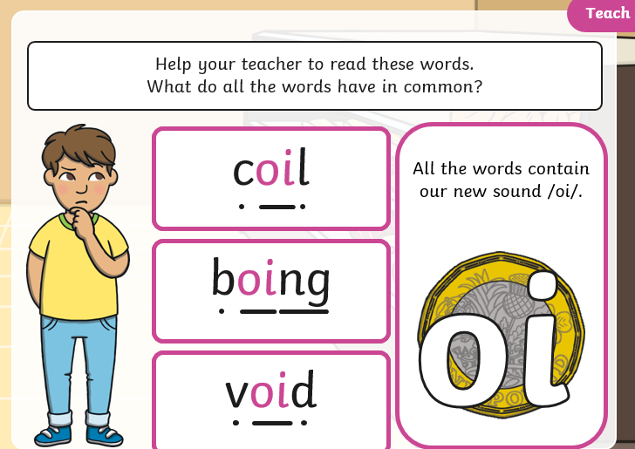
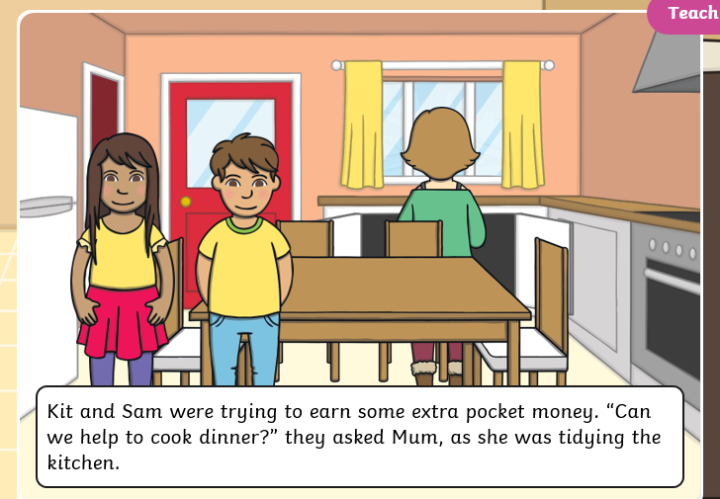
Twinkl phonics
We use twinkl phonics scheme which is approved by the Department of Education.
These are screenshots of some of the slides we show to children.

Slide 7
Phonic terms
Phoneme:
The smallest units of sound in a word.
How many phonemes in:
at?
shop?
chair?

Slide 8
Pure sounds
We use pure sounds to teach phonics
Some sounds are long and stretchy (l, m)
Some sounds are short and bouncy (a, t)
Knowing if they are long or short helps with blending.

Slide 9
Phonic terms
grapheme:
This is how the sound is written down
d t ear l
oi ow qu

Slide 10
Phonic terms
Digraph:
Two letters that make one sound
e.g. sh, ch, th, ai, ee, ea
Can you spot the digraphs in:
sheep?
grain?

Slide 11
Phonic terms
Trigraph:
Three letters that make one sound
e.g. igh, ure, air, ear
Can you spot the trigraphs in:
night
sure
fairness
pure
fearful?

Slide 12
Phonic terms
Split-digraph:
Two letters that make one sound but are split within the word by another letter:
e.g. a-e (make), i-e (time), o-e (tone),
u-e (tune)
Can you spot the split digraphs in:
these
like
prune

Slide 13
Phonics is taught in 6 key phases

Slide 14
Phase 1
Phase 1 is all about getting ready for phonics.
Phase 1 activities consist of seven aspects:
environmental sounds , instrumental sounds, body percussion, rhythm and rhyme, alliteration, voice sounds, oral blending and segmenting.
Oral blending and segmenting the sounds in words are integral parts of the later stages of Phase One.
Phase 1 is taught in nursery. This is a key skill which is vital to children’s phonological development.

Slide 15
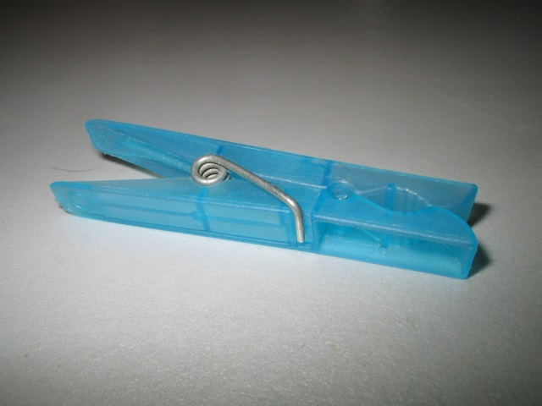
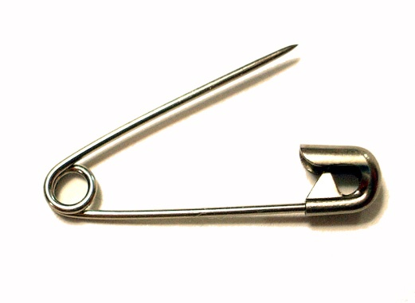
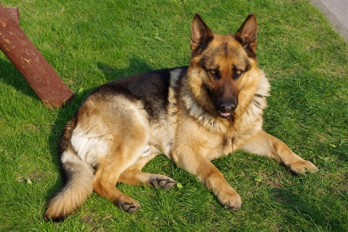
Phase 1 Activity
Can you spot the…
Stretch this word...

Slide 16
Phase 2
Phase 2 is taught at the beginning of FS2 and is about learning phonemes (letters) in order to then read and write simple words.
In Phase 2 children will learn the first 19 Phonemes
s a t p i n m d g o c k ck e u r h b l f ck ss ll ff
Children will use these phonemes to read and write CVC (consonant, vowel, consonant) words, like c-a-t.
In phase 2 they will also learn 5 tricky words: the, I , no, go, to.

Slide 17
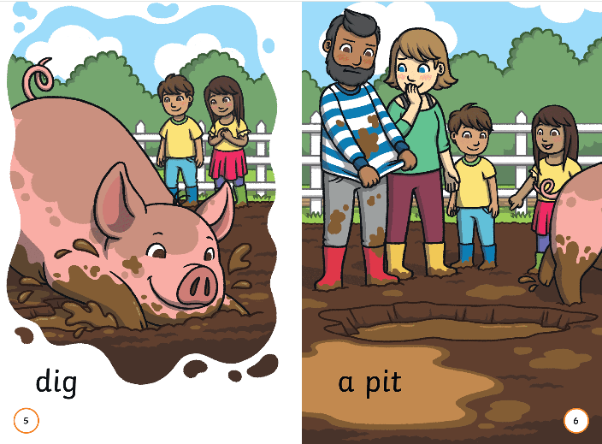
Reading at home. If your child cannot remember the sound a letter makes, tell them what the sound is. This builds letter-sound recognition.

Slide 18
Phase 3
Children will enter Phase 3 in Foundation Stage. once they are confident with the first 19 phonemes and are beginning to blend and segment CVC words.
During Phase 3, children will learn another 26 phonemes. Children are also introduced to digraphs and trigraphs.
j v w y z zz qu ch sh th ng ai ee igh oa oo ar or ur ow oi ear air ure er
Children will use these phonemes and the ones from Phase 2 to read and spell words.

Slide 19
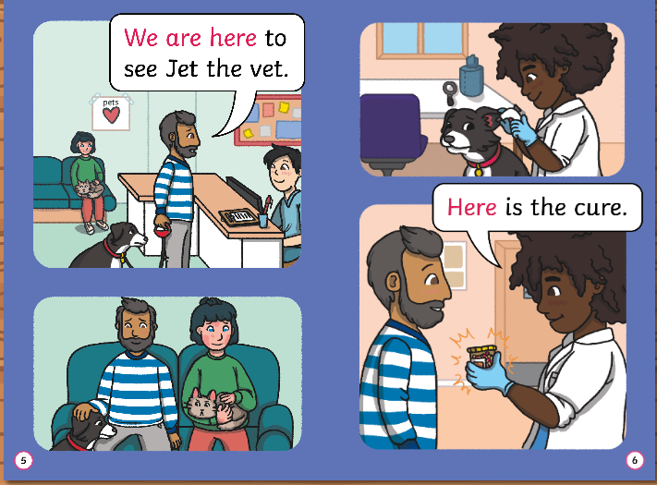

Slide 20
Phase 4
In Phase 4 no new phonemes are learnt but it focuses on applying previous knowledge by reading and spelling longer words with the phonemes they already know.
These words have tricky consonant clusters such as..
trip clap green skimp burnt spend string

Slide 21
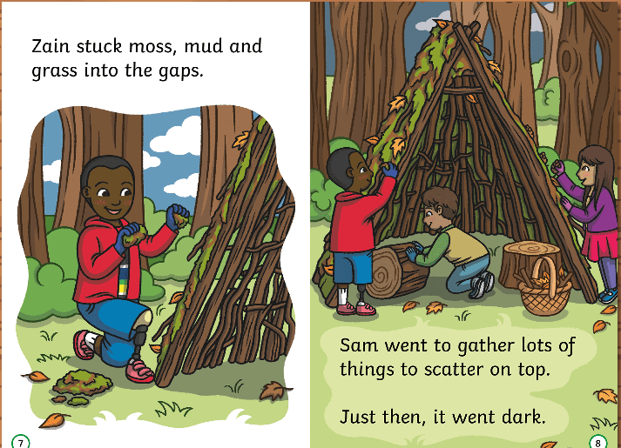

Slide 22
Phase 2, 3 & 4 Activity
We use sound buttons to make it clear where the sounds are in the words:
bed
A dot indicates a single letter phoneme.
A line shows a digraph.
chop

Slide 23
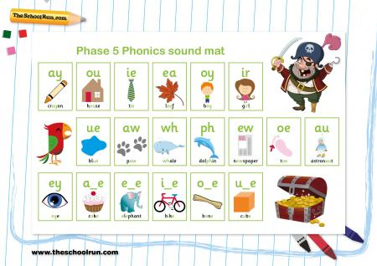
During writing lessons, we use phonics sound mats with visual clues to help children sound out words.

Slide 24
Phase 5
Children will enter phase 5 in Year 1 and should complete their learning within the year. During Phase 5 children will learn new graphemes and learn that they make the same sound as some of the phonemes they have already learnt.
ay ou ie ea oy ir ue aw wh ph ew oe au
Children will also learn about split digraphs:
a-e e-e i-e o-e u-e
e.g. take cube pine

Slide 25
Phase 5
In Phase 5 children also learn alternative pronunciations:
e.g. school chord
Children will learn that the same grapheme can represent different phonemes:
meat bread

Slide 26
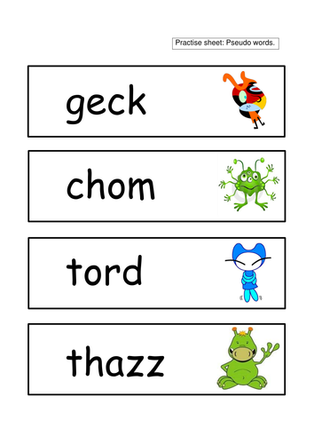
Year 1 Phonics Screening Test.
This takes place nationwide during the week commencing
Monday 9th June 2024.
This test consists of 40 words to read aloud.
Twenty of these words will be real words that the children may be familiar with.
Twenty of these words will be pseudo words, containing some of the phonics sounds taught from phase 2 onwards.

Slide 27
Year 1 Phonics Screening Test.
Children will not be aware that they are being assessed. Teachers will present the screening as a game.
Children are encouraged to sound out the word and blend it.
Children are allowed to annotate the test using sound buttons and dashes. This is a familiar process to children.
Staff are not allowed to support the children’s reading during the test.
There is an opportunity for children who do not achieve the required pass mark in Year 1 to retake the test in Year 2.

Slide 28
How can I help my child?
Know which sounds they are learning in school.
Look for this grapheme written everywhere.
Practise previously taught graphemes.
Play games with them
(bingo with objects, mix up printed letters to make words, wordsearch, write graphemes on pieces of paper – jump on them)
Use alphablocks, phonics play, twinkl phonics
Make letters out of playdough
Make sure they can write their names
Noughts and crosses with graphemes to read before they can add a counter

Slide 29
Books
Books that are sent home will match the phase and week that children are reading at, or will give them practice at previously taught graphemes.
Your child will not be sent home with a book which contains sounds that they have not been taught.

Slide 30
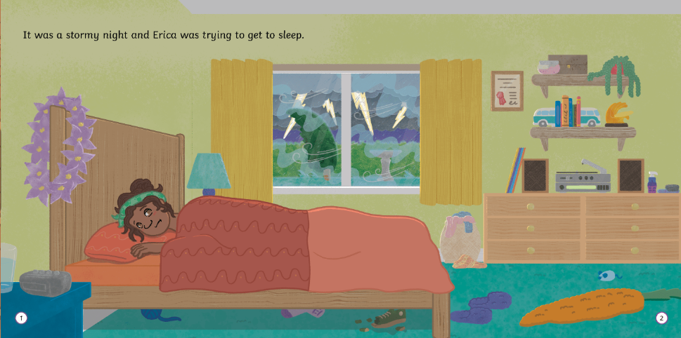
Alternative pronounciation of y
Comprehension questions: Why do you think she couldn’t she sleep? Do you remember that time when you couldn’t sleep?

